Slide 1

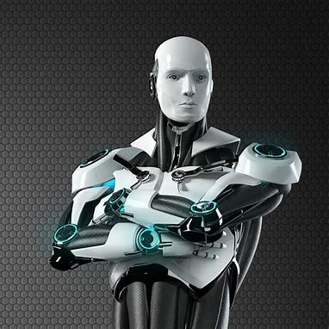
AI, THE HELPUL PIRATE. WILL THERE BE ANY JOBS LEFT FOR US?

Slide 2
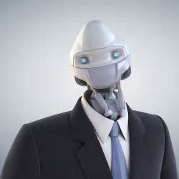
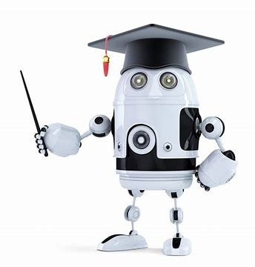
Artificial intelligence has already been introduced to several jobs, boosting work beyond human's capacity and efficiency. Who's to say that offices, laboratories and schools won't be ai reliant only

Slide 3
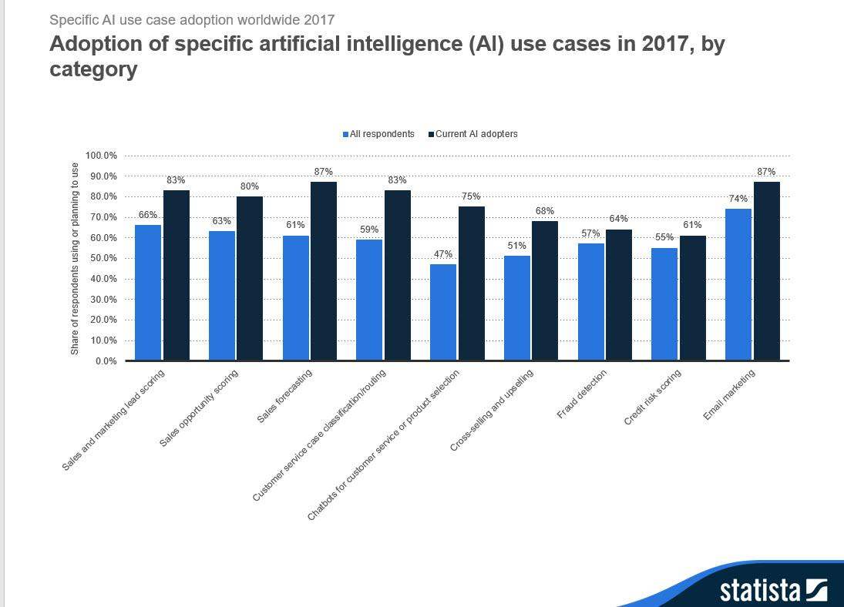
this graph shows how much more people are relying on ai for more efficient and quicker work

Slide 4
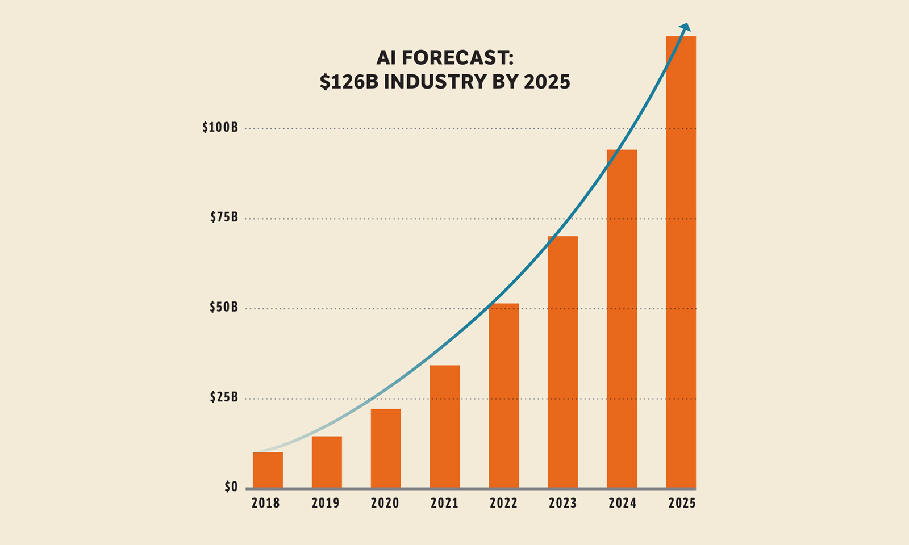
THIs graph shows how ai is on a steady incline, verifying the threat it causes to employment

Slide 5
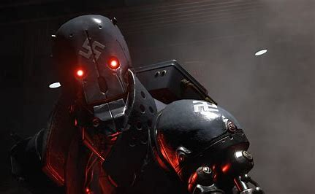
AT the Moment there's still certain jobs ai can't do or help with. but in our ever-developing society, soon there will be nothing that artificial intelligence won't be able to replace

